Slide 1

Predicting Credit Card Faud
2023 Dataset used to build this predictive model

Slide 2

Introduction to the team
Thanh
Masha
Richard
Mel

Slide 3


Machine Learning and Libraries Used
Import and Clean Data with SQL
Create Jupyter Notebook and import SQL file
Test and Train the Model to detect Fraud
Random Forest used as most reliable
Accuracy
Outcome

Slide 4



Overview of the Dataset
This dataset encapsulates credit card transactions sourced from European cardholders throughout 2023. Constituting a formidable dataset of over 550,000 records, the data undergoes rigorous anonymisation protocols to safeguard the identities and locations of the cardholders. Our primary directive revolves around harnessing this dataset's potential to refine and enhance our data model, enabling the discernment of fraudulent activities within the financial landscape with greater precision and efficiency.
Dataset source: https://www.kaggle.com/datasets/nelgiriyewithana/credit-card-fraud-detection-dataset-2023?resource=download
Features of the dataset (columns):
id: Unique identifier for each transaction
V1-V28: Anonymized features representing various transaction attributes (e.g., time, location, etc.)
Amount: The transaction amount
Class: Binary label indicating whether the transaction is fraudulent (1) or not (0)
This data was uploaded to SQLPosgres and imported into a Python Notebook to create the machine learning models.

Slide 5

Supervised vs Unsupervised Machine learning
Why We Chose Supervised Machine Learning for Our Dataset:
Labeled Data: In credit fraud detection, our dataset includes labeled examples of fraudulent and non-fraudulent transactions (0 = Non-fraudulent and 1 = Fraudulent). This labeled data is crucial for training supervised learning models.
Classification Task: Credit fraud detection is essentially a binary classification problem: classify transactions as either fraudulent or non-fraudulent. Supervised learning classification models are well-suited for this task as they learn to predict the class labels based on input features.
Why Unsupervised Is Not Suited:
Relies on Unlabeled Data.
Detection Challenges: Unsupervised learning identifies patterns but may struggle to discern normal from fraudulent transactions. Supervised learning, leveraging labeled data, captures nuanced differences for accurate predictions.
Evaluation Complexity: Unsupervised methods face challenges in evaluating performance without labeled data. Supervised models offer objective assessment through metrics like precision, recall, and F1-score

Slide 6
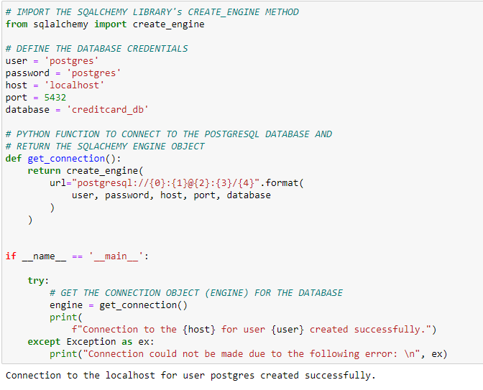
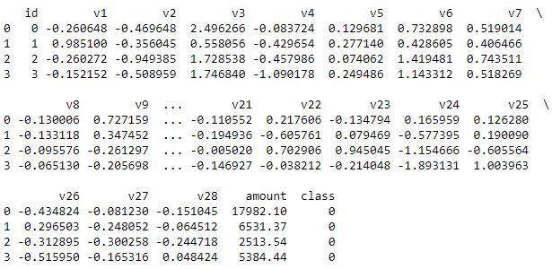
Data processes
Cleaning the dataset:
Checked for any null values
Checked the data types (pandas function (.dtypes)) of each columns (e.g., object, float, integer)
Utilized a SQL database:
Created a database on Postgres and table to hold our csv data
Used psycopg2 to query the stored database and table on Postgres
Read in CSV
Notes:
CSV datasets 99% cleaned

Slide 7
Model 1 Logistic Regression
Model 1 – Logistic Regression
Presession and Accuracy
Our first model test is the Logistic Regression Machine Learning Model that captured a phenomenal 99.83% Accuracy. The data set comprised of almost 50% Fraudulent and 50% Nonfraudulent credit card transactions. With such a high score we decided to try a new model to see if this we could predict 100% accuracy.
Logistic Regression Accuracy: 0.9983556970261858
precision recall f1-score support
Class 0 1.00 1.00 1.00 56734
Class 1 1.00 1.00 1.00 56992
accuracy 1.00 113726
macro avg 1.00 1.00 1.00 113726
weighted avg 1.00 1.00 1.00 113726

Slide 8
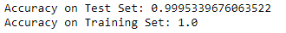
Model 2 Decision Tree
Model 2 –Decision tree
Presession and Accuracy
Our third model test is the Decision Tree Machine Learning Model that achieved an accuracy of 99.9%.
As seen with the last 2 machine learning models, they all achieved an accuracy of 99.9%. Therefore, the model was able to learn and detect fraudulent and non-fraudulent payments with a very high accuracy.

Slide 9
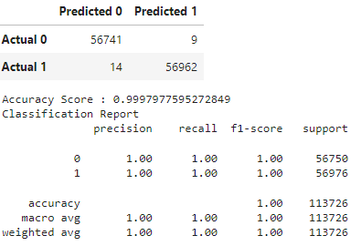
Model 3 Random Forrest
Model 3 – Random forest
Presession and Accuracy
Our second model test is the Random Forrest Machine Learning Model that captured a phenomenal 99.97% Accuracy.

Slide 10
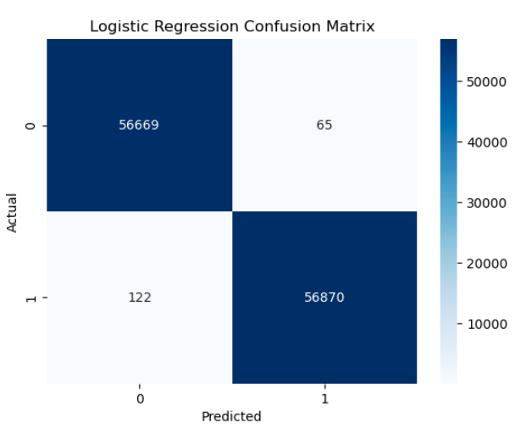

Confusion Matrix Model
Model 1 – Confusion Matrix
As a result of the Confusion Matrix, we can draw the following conclusions:
A total of 56,734 predictions were made for the Non-Fraud class (class = 0), of which 56,669 (TN) were correct and 65 (FP) were incorrect.
A total of 56,992 predictions were made for the Fraud class (class = 1), of which 122 (FN) were wrong and 56,870 (TP) were correct.
In conclusion, the model was very successful in predicting both the fraud and non-fraud classes due to the high TN and TP.

Slide 11

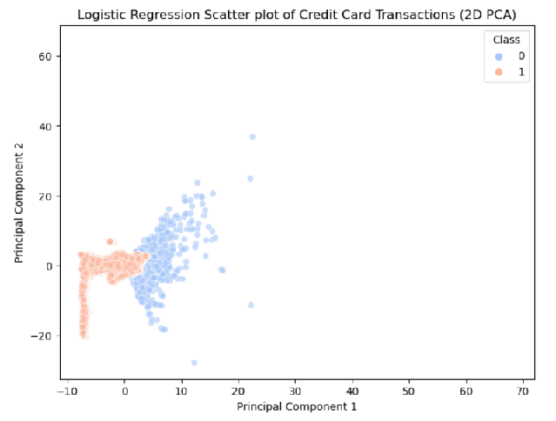
Logistic Regression Scatter Plot of Credit Card Transactions
Clusters represent distinct patterns or behaviors, such as regular transactions, large purchases, or frequent small transactions.
Anomalies or Outliers: Clusters highlight outliers or anomalies within the dataset, which may indicate unusual or fraudulent behavior.
Homogeneous Subpopulations: Clusters indicate the presence of subpopulations with similar characteristics, such as different demographics or customer segments.
Fraud Detection: Clusters help identify patterns of fraudulent activity, distinguishing them from legitimate transactions.
Capture of Temporal Trends: Clusters may capture temporal trends or seasonality in the data, such as transaction frequency at specific times.

